Slide 1
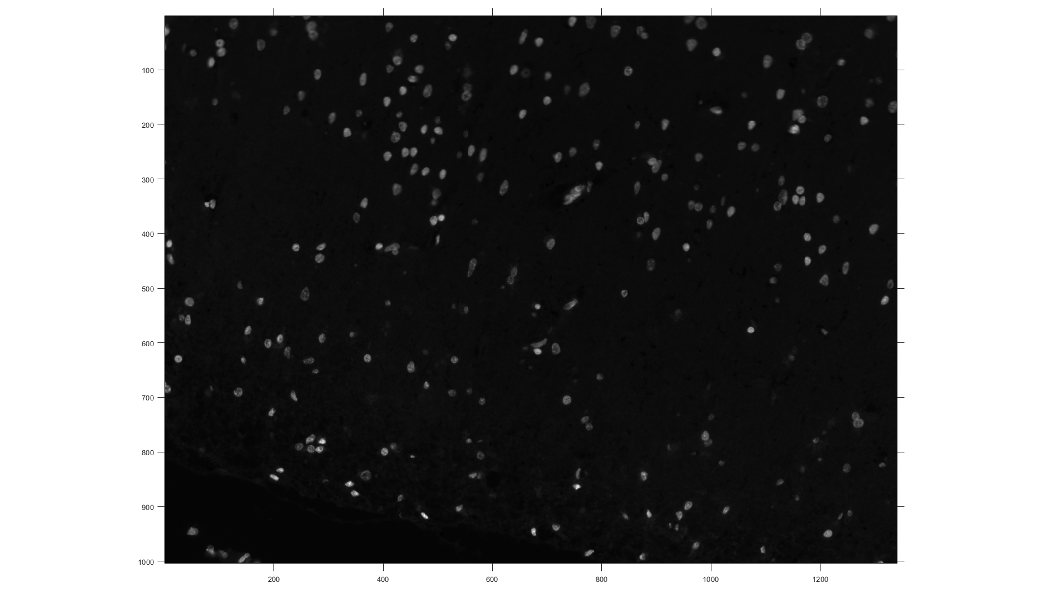
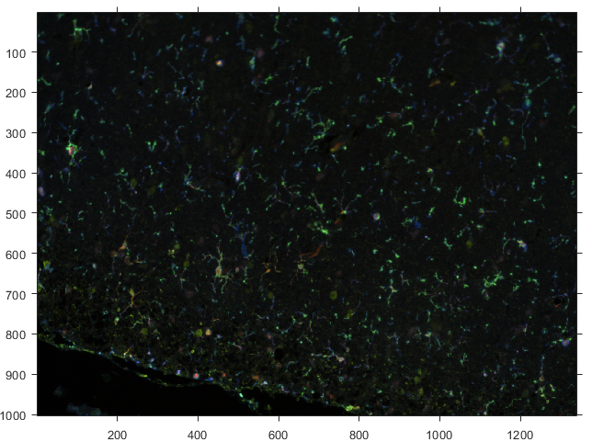
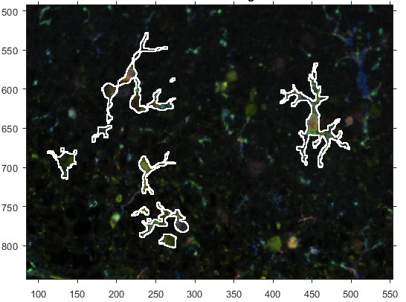
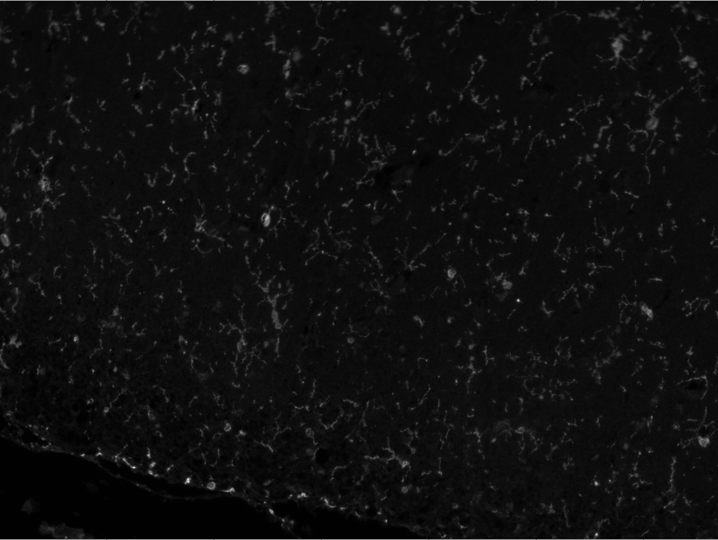
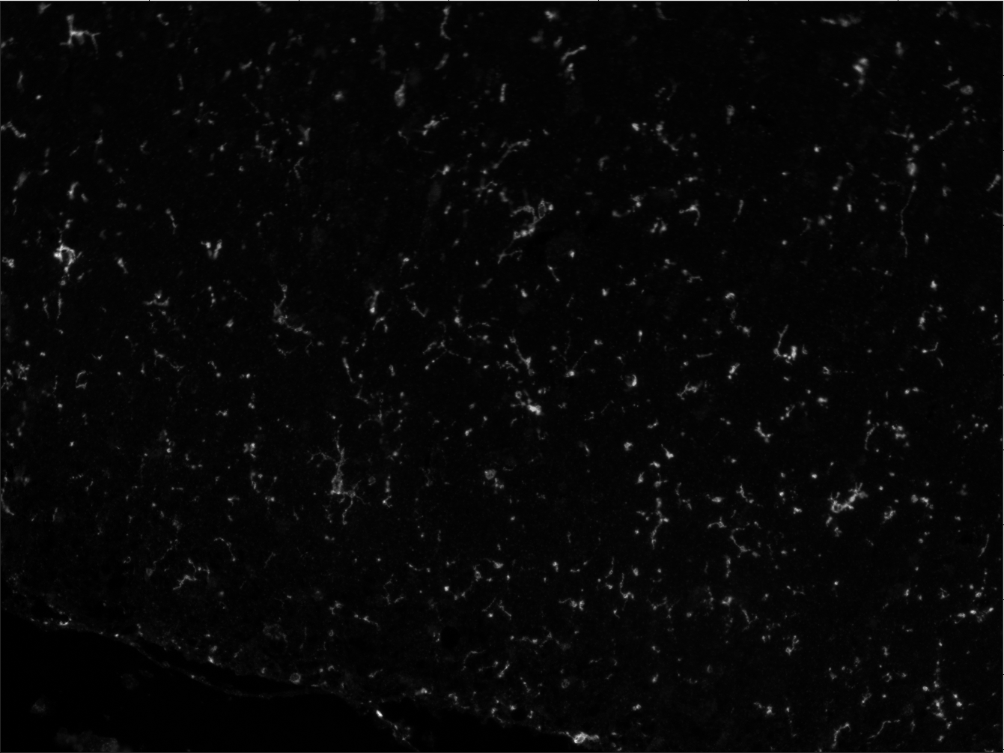

Research/Master project: Cell segmentation of microglia cells
Dataset
Problem Definition:
Identify the separate parts that belong to the same cell (Multiple object recognition)
Color-coded image
Ground truth segmentation
Nucleus
Cell #2
Cell #1
5 Proteins
Cell #3
~1300 Images
Requirements:
Proposed Novel Methodology:
Basic knowledge in Image Processing
Good programming skills:Python or Matlab
A supervised approach using the ground-truth data, using Deep Learning architectures [1].
A semi-supervised approach using the “visual analytics” paradigm [2].
[1]Caicedo, Juan C., et al. "Evaluation of Deep Learning Strategies for Nucleus Segmentation in Fluorescence Images." BioRxiv (2019): 335216.
[2] Ai-Awami, Ali K., et al. "Neuroblocks–visual tracking of segmentation and proofreading for large connectomics projects." IEEE transactions on visualization and computer graphics 22.1 (2015): 738-746.
Supervisor: Antonios Somarakis, Thomas Höllt, Boudewijn Lelieveldt Contact: Antonios Somarakis, a.somarakis@lumc.nl

Slide 2
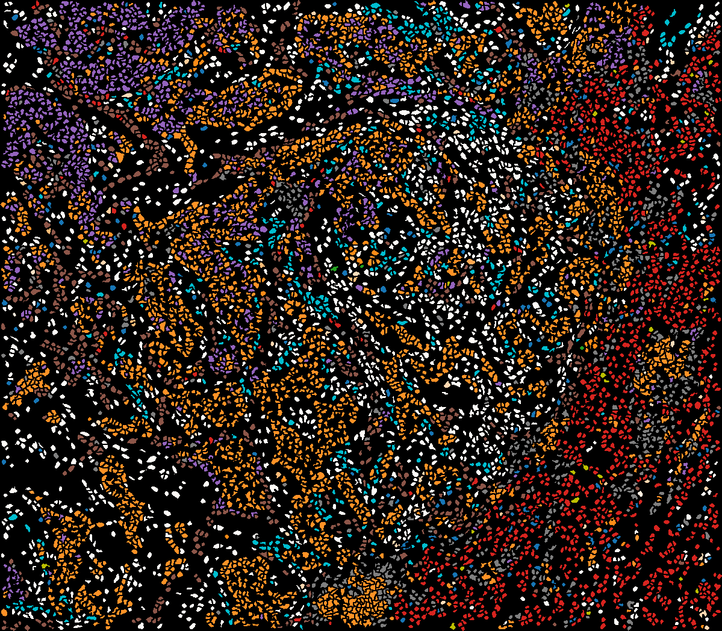
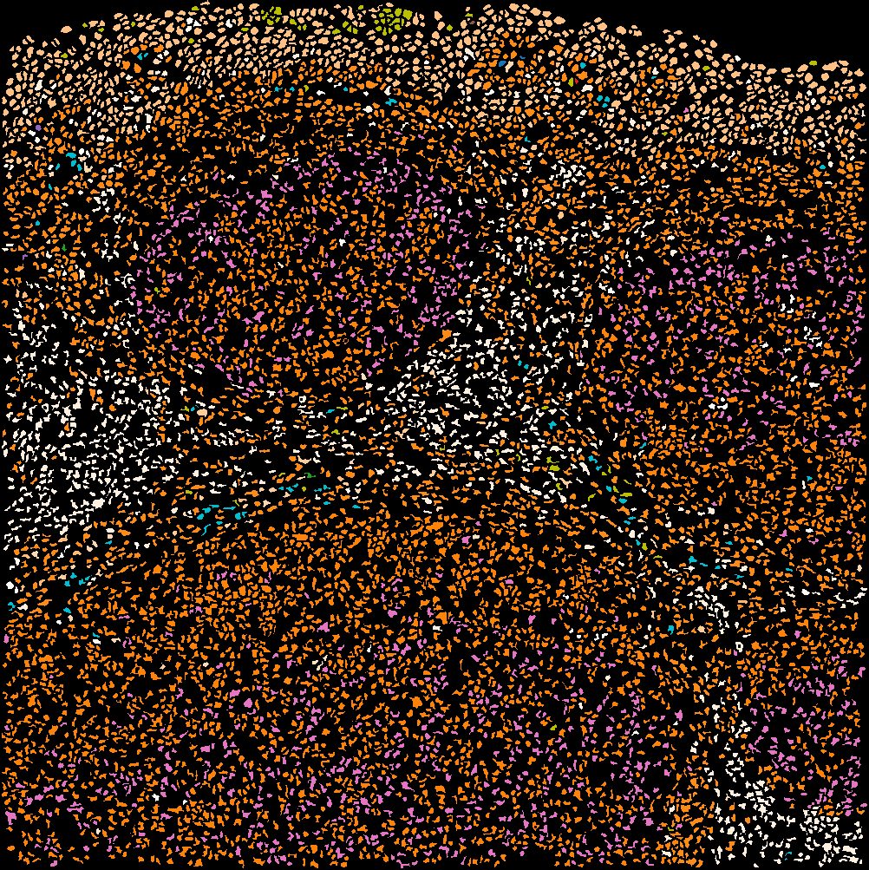
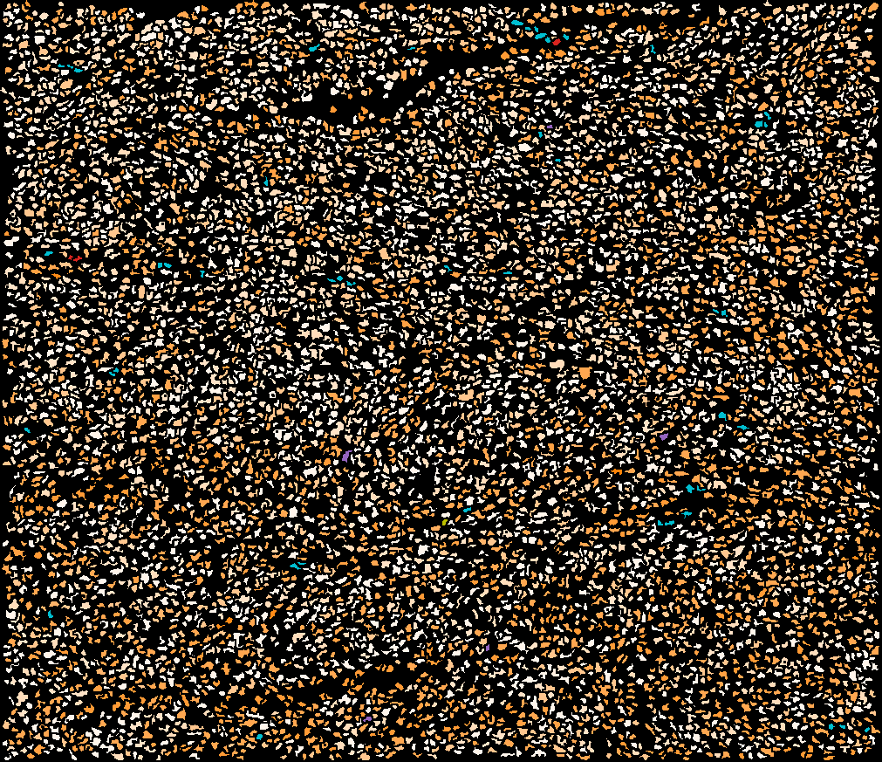
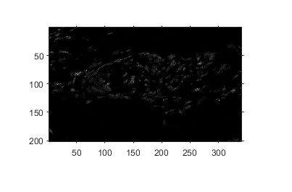
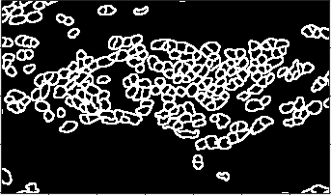
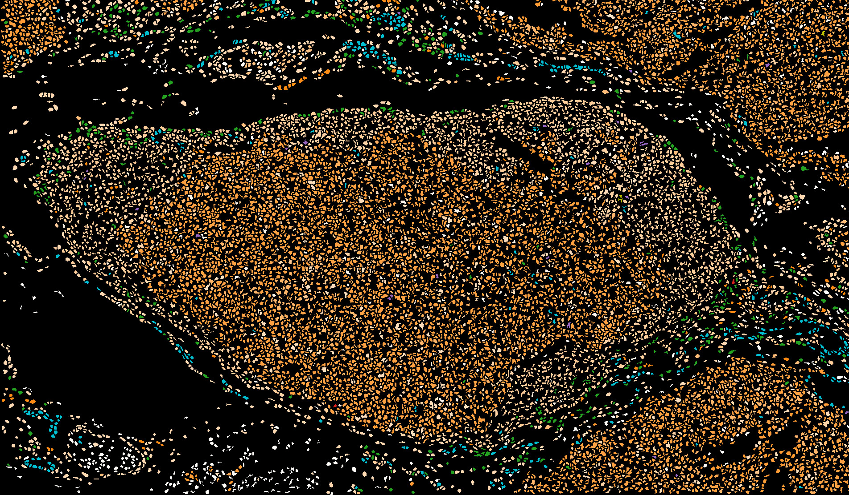
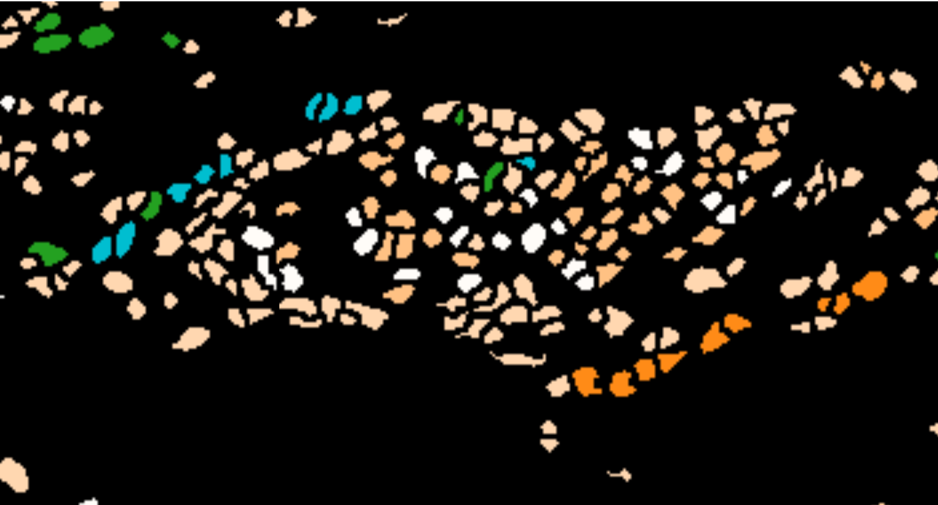
Research/Master project: Semi-supervised classification of Multi-spectral images
Data/ Preprocessing Pipeline
Problem definiton:
>40 Proteins, Clinical Data, Unique Data in NL
Segmentation Mask
Different dimensions per image
Different amount of cells per image
Different cell types per image
Different patient
Healthy
Cancer, First stage
Cancer, Fatal stage
?
Cell Type identification (Each color represent a different cell type[2])
Requirements:
Proposed Novel Methodology:
Basic knowledge in Data Science, Graph mining
Good programming skills:Python or Matlab
Extract features for each cell [1,2]
Extract the topology of the cells in networks
Utilize the network topology[2] + cell features to classify the images according to their clinical relevance
[1] Hollt, Thomas, et al. "Visual analysis of mass cytometry data by hierarchical stochastic neighbour embedding reveals rare cell types." Nature communications 8.1 (2017): 1740. [2]Somarakis, Antonios et al. “Visual Exploration of Imaging Mass Cytometry Data.’’ (conditionally accepted)
[3] Kipf, Thomas N., and Max Welling. "Variational graph auto-encoders." arXiv preprint arXiv:1611.07308 (2016).
Supervisor: Antonios Somarakis, Thomas Höllt, Boudewijn Lelieveldt , Contact: Antonios Somarakis, a.somarakis@lumc.nl

